Slide 1
SJU DSS680 Final Project Submitted to: Dr. Yi Submitted by: Deepak Walia

Slide 2
Objective
Recommend Joseph's Pharmaceuticals which prescription (Rx) product to add to their CNS (central nervous system) product portfolio
 | Depression Product
 | Efficacy1 | Efficacy2 | Pricing | Safety | Convenience | Packaging | Marketing | Conferences | Targeting
Baseline | 5 | 6 | 7 | 5 | 6 | 6 | 5 | 6 | 5
Upside | 6 | 7 | 8 | 6 | 7 | 7 | 6 | 7 | 6
Downside | 4 | 5 | 6 | 4 | 5 | 5 | 4 | 5 | 4
 | Insomnia Product
 | Efficacy1 | Efficacy2 | Pricing | Safety | Convenience | Packaging | Marketing | Conferences | Targeting
Baseline | 6 | 5 | 6 | 5 | 7 | 6 | 5 | 6 | 6
Upside | 7 | 6 | 7 | 6 | 8 | 7 | 6 | 7 | 7
Downside | 5 | 4 | 5 | 4 | 6 | 5 | 4 | 5 | 5

Slide 3
Depression
 | Growth rate | Year1 | year2 | Year3 | Year4 | year5
US Adult Population | 0.77% | 220,000,000 | 221,694,000 | 223,401,044 | 225,121,232 | 226,854,665
 | YoY increase
Number of Medicare & Medicaid Members* | 2.50% | 51,800,000 | 53,095,000 | 54,422,375 | 55,782,934 | 57,177,508
 | % of members
Diagnosis of Depression for Medicare & Medicaid members** | 15.00% | 7,770,000 | 7,964,250 | 8,163,356 | 8,367,440 | 8,576,626
Severe cases who do not respond to commonly available medication**** | 70.00% | 5,439,000 | 5,574,975 | 5,714,349 | 5,857,208 | 6,003,638
% Treated with Rx *** | 67.00% | 3,644,130 | 3,735,233 | 3,828,614 | 3,924,329 | 4,022,438
 | Market Share | 30.00% | 50.00% | 80.00% | 100.00% | 100.00%
Upside | 28.82% | 8.65% | 14.41% | 23.06% | 28.82% | 28.82%
base | 35.10% | 10.53% | 17.55% | 28.08% | 35.10% | 35.10%
Downside | 23.44% | 7.03% | 11.72% | 18.75% | 23.44% | 23.44%
Patient Upside |  | 315,071 | 538,247 | 882,725 | 1,130,992 | 1,159,267
Patient base |  | 383,727 | 655,533 | 1,075,075 | 1,377,440 | 1,411,876
Patient Downside |  | 256,255 | 437,769 | 717,942 | 919,863 | 942,859
Cost of Drug | $4
Days per year | 300
$ Update |  | $ 378,085,776 | $ 645,896,534 | $ 1,059,270,315 | $ 1,357,190,091 | $ 1,391,119,843
$ base |  | $ 460,472,267 | $ 786,640,122 | $ 1,290,089,801 | $ 1,652,927,557 | $ 1,694,250,746
$ Downside |  | $ 307,506,266 | $ 525,323,204 | $ 861,530,055 | $ 1,103,835,383 | $ 1,131,431,268
* www.cnsnews.com/news/article/terence-p-jeffrey/census-bureau-118395000-government-health-insurance-2015-28966000
** www.cms.gov/About-CMS/Agency-Information/OMH/Downloads/OMH_Dwnld-DataSnapshot-Depression.pdf
*** www.everydayhealth.com/depression/drugs.aspx
**** www.cms.gov/medicare-coverage-database/details/technology-assessments-details.aspx?TAId=105&bc=AAAQAAAAAAAA&

Slide 4
Insomnia
 | Population Growth | Year1 | year2 | Year3 | Year4 | year5
Adult Population | 0.77% | 220,000,000 | 221,694,000 | 223,401,044 | 225,121,232 | 226,854,665
Uninsured adults of total* | 4% | 27,000,000 | 27,000,000 | 27,000,000 | 27,000,000 | 27,000,000
Adult Population - Number of Uninsured Adults (Total Insured) |  | 193,000,000 | 194,694,000 | 196,401,044 | 198,121,232 | 199,854,665
Percentage of People with Insomnia** | 25% | 48,250,000 | 48,673,500 | 49,100,261 | 49,530,308 | 49,963,666
People who develop acute insomnia*** | 6% | 2,895,000 | 2,920,410 | 2,946,016 | 2,971,818 | 2,997,820
 | Market Share | 50.00% | 80.00% | 100.00% | 100.00% | 100.00%
Upside | 24.19% | 7.26% | 12.10% | 19.35% | 24.19% | 24.19%
base | 28.27% | 8.48% | 14.14% | 22.62% | 28.27% | 28.27%
Downside | 19.69% | 5.91% | 9.85% | 15.75% | 19.69% | 19.69%
Patient Upside |  | 210,090 | 353,224 | 570,113 | 718,883 | 725,173
Patient base |  | 245,525 | 412,800 | 666,271 | 840,133 | 847,484
Patient Downside |  | 171,008 | 287,514 | 464,056 | 585,151 | 590,271
Cost of Drug | $7
Days per year | 150
$ Update |  | $220,594,658 | $370,884,769 | $598,618,597 | $754,827,034 | $761,431,286
$ base |  | $257,801,198 | $433,439,951 | $699,584,446 | $882,139,738 | $889,857,894
$ Downside |  | $179,558,033 | $301,890,083 | $487,259,206 | $614,408,611 | $619,784,292
* https://www.kff.org/uninsured/fact-sheet/key-facts-about-the-uninsured-population/
** https://www.sciencedaily.com/releases/2018/06/180605154114.htm
*** http://sleepeducation.org/news/2014/03/10/insomnia-awareness-day-facts-and-stats

Slide 5
Based on my analysis, Depression Rx has a better potential.
Depression
 | Year1 | year2 | Year3 | Year4 | year5
$ Update | $ 378,085,776 | $ 645,896,534 | $ 1,059,270,315 | $ 1,357,190,091 | $ 1,391,119,843
$ base | $ 460,472,267 | $ 786,640,122 | $ 1,290,089,801 | $ 1,652,927,557 | $ 1,694,250,746
$ Downside | $ 307,506,266 | $ 525,323,204 | $ 861,530,055 | $ 1,103,835,383 | $ 1,131,431,268
Insomnia
 | Year1 | year2 | Year3 | Year4 | year5
$ Update | $ 220,594,658 | $ 370,884,769 | $ 598,618,597 | $ 754,827,034 | $ 761,431,286
$ base | $ 257,801,198 | $ 433,439,951 | $ 699,584,446 | $ 882,139,738 | $ 889,857,894
$ Downside | $ 179,558,033 | $ 301,890,083 | $ 487,259,206 | $ 614,408,611 | $ 619,784,292

Slide 6
Following Slides will demonstrate the SAS Enterprise Miner workflow
First for Depression drug
Finally for Insomnia drug

Slide 7
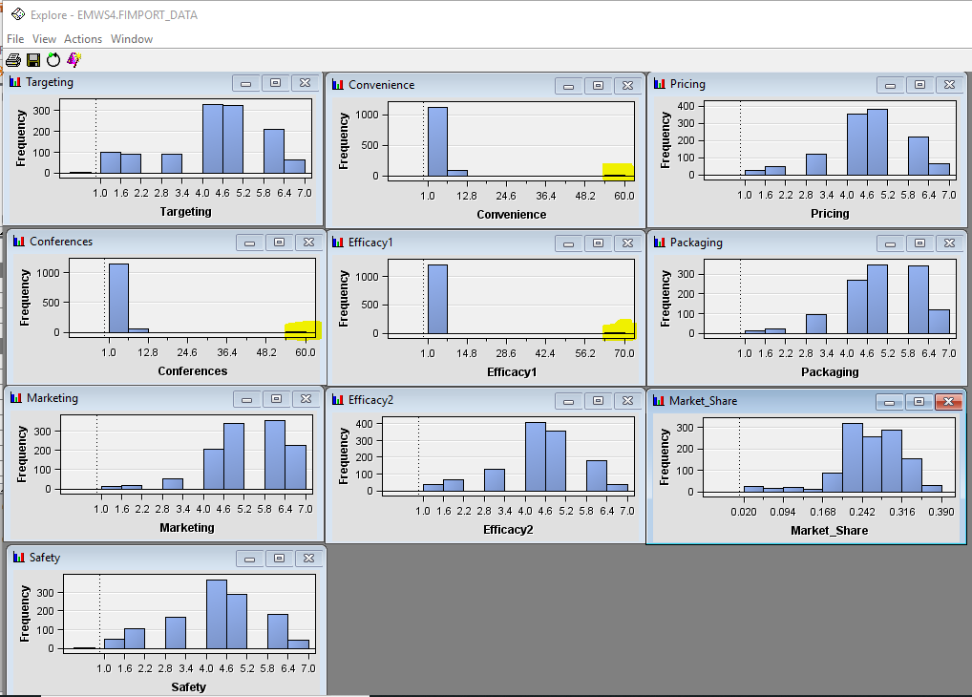
Exploring variables
I see some variables have a much higher value when our range is 1-10
Depression Dataset

Slide 8
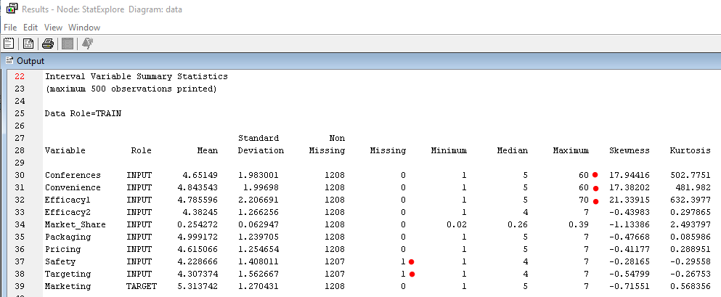
StatExplorer We can see three variables have maximum value higher than the allowable limit.. Also, 2 variables have one missing value each.
Depression Dataset

Slide 9
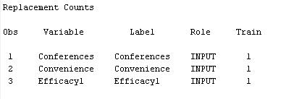
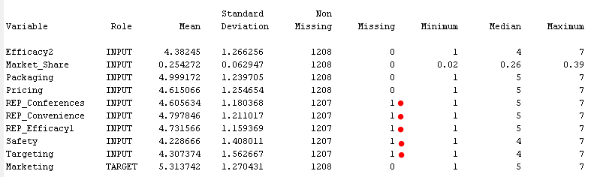
Replacement Using replacement node, I have replaced variables with value higher than maximum(10) to blank. Now, we can see five variables have one missing values each.
Depression Dataset

Slide 10

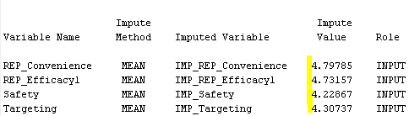
Data Partition & Impute 70-30 partition and impute missing values with mean
Depression Dataset

Slide 11
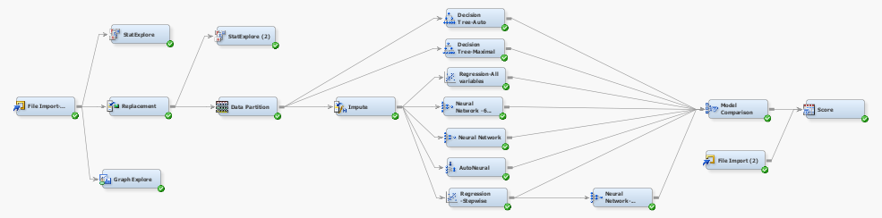
Model diagram
Depression Dataset

Slide 12
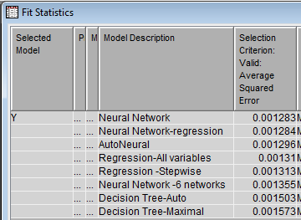
Model Comparison Neural Network with 3 hidden units has the least ASE on Validation dataset
Depression Dataset

Slide 13
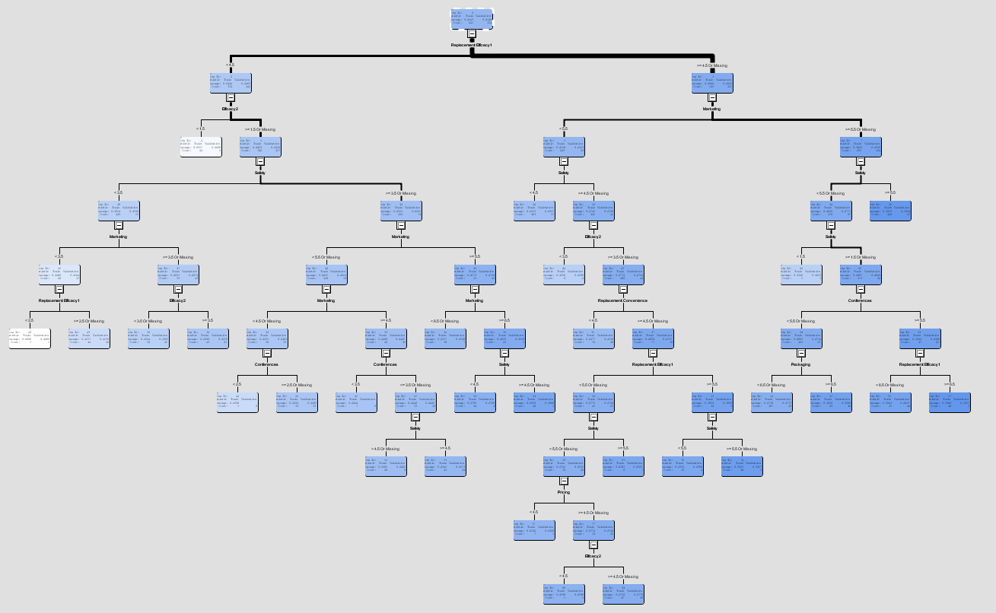
Decision Tree
Depression Dataset

Slide 14
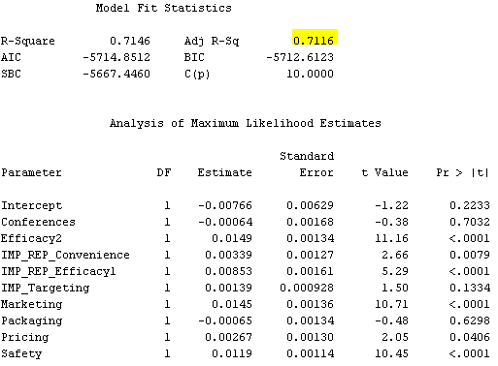
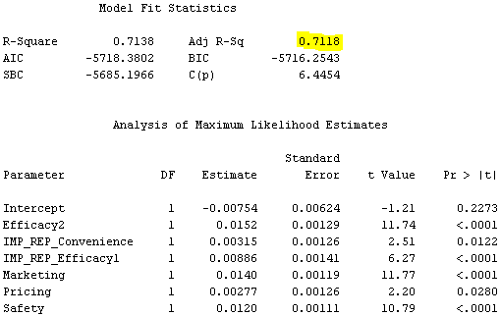
Linear Regression
Depression Dataset
The Regression model explains approx. 71% of the variations in data.
Regression – All variables
Regression - Stepwise

Slide 15
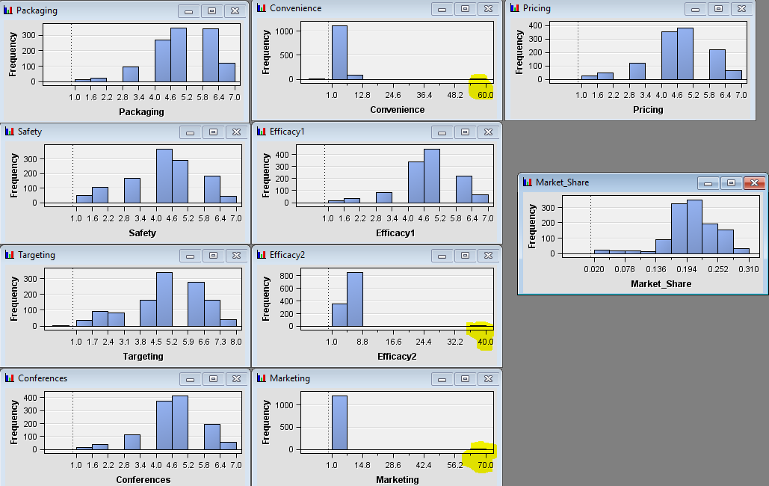
Exploring variables
I see some variables have a much higher value when our range is 1-10
Insomnia Dataset

Slide 16
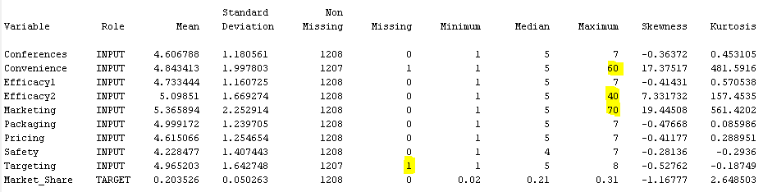
StatExplorer We can see three variables have maximum value higher than the allowable limit.. Also, 1 variables has one missing value.
Insomnia Dataset

Slide 17
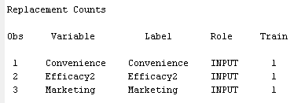
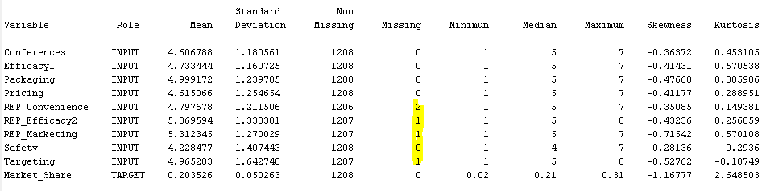
Replacement Using replacement node, I have replaced variables with value higher than maximum(10) to blank. Now, we can see five variables have one missing values each.
Insomnia Dataset

Slide 18
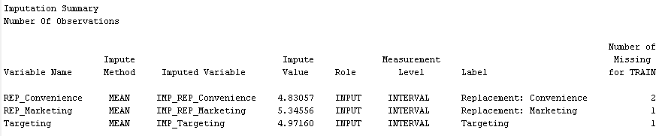
Data Partition & Impute 70-30 partition and impute missing values with mean
Insomnia Dataset

Slide 19
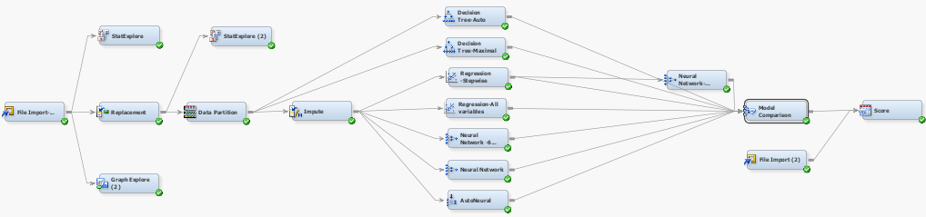
Model diagram
Insomnia Dataset

Slide 20
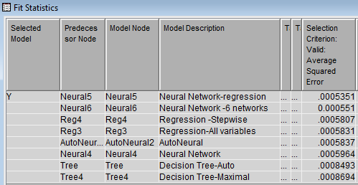
Model Comparison Neural Network with plugged in with a stepwise regression has the least ASE on Validation dataset
Insomnia Dataset

Slide 21
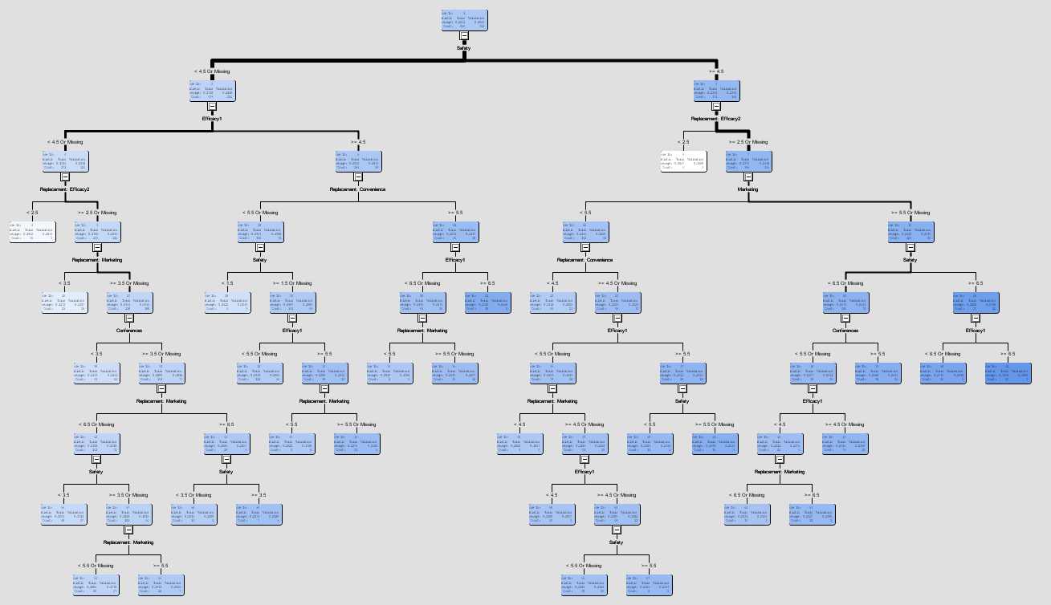
Decision Tree
Insomnia Dataset

Slide 22
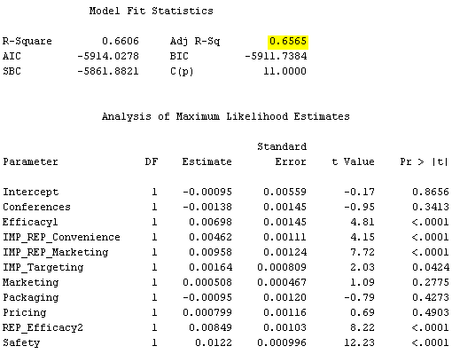
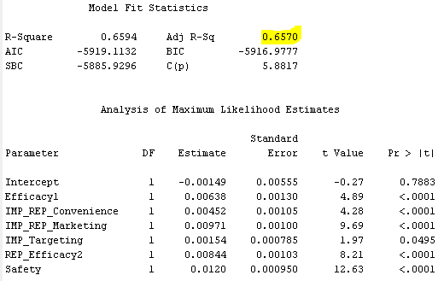
Linear Regression
Insomnia Dataset
The Regression model explains 65% of the variations in data
Regression – All variables
Regression - Stepwise

